Slide 1

Logistics on the Old Backroads
Backroads Bulletin
Business Intelligence w/
Professor Josh Bell, MBA
Presentation by
Chris Wibe

Slide 2
CONSULTING ENGAGEMENT OBJECTIVES
To recognize the reason for how sales have fallen dramatically following Backroads Bulletin’s recent move to Alliance, Nebraska
To ascertain the precise reason why fewer customers are buying from us and why fuel has become scarce
To gather information regarding customers’ preferences regarding road type, road length, and truck type

Slide 3
TRUCKING in 1908
Back in 1908, transportation of freight was primarily by train
For the transportation industry, the amount of fuel and time necessary for cargo to reach a destination heavily influenced the company’s profitability overall
Railroads dominated the country east of the Mississippi, but further west a small trucking company might compete with the trains since long western railroads were difficult to manage

Slide 4
Interview with Dr. Schmidt: “The Three Golden Questions”
“What are
fuel prices
going to look like?”
“What is consumer demand for each type of route going to look like?”
“What is
customer volume
going to look like?”

Slide 5



DATA MODEL
TruckRoute
TruckRouteID
TruckRouteName
TruckRouteType
TruckRouteStartCity
TruckRouteEndCity
TruckRouteMileLength
TruckRouteFuelUsageGallons
Customer
CustomerID
TrucktoCustomer
Fuel
CustomerFirstName
TrucktoCustomerID
FuelID
CustomerLastName
TrucktoCustomerDate
FuelName
CustomerType
TrucktoCustomerTruckRouteID
FuelPriceDollarstoGallons
CustomerAddressLine1
TrucktoCustomerTruckID
CustomerAddressLine2
TrucktoCustomerCustomerID
CustomerCity
TrucktoCustomerFuelID
CustomerState
TrucktoCustomerRevenue
CustomerZIP
CustomerRegion
Truck
TruckID
TruckName
TruckType
TruckPriceDollars

Slide 6

Sample QuerY SELECT * FROM TruckRoute WHERE TruckRouteMileLength > 9975
ID Route Type Start End Miles Gallons
296 bmtra backroad xaoja fcftu 9983 6
937 eraan interstate dklol xsuxy 9985 1
1034 qhadk interstate wutrm wfksf 9993 9
1103 cwcuk interstate bkirb juflt 9982 3
2514 hllcu backroad kptyx sooyq 9984 5
2718 xqevw interstate wuauc gngbe 9997 3
3786 ejvxj interstate fyhpc msacy 9983 4
3918 nqecm interstate varab rcdxq 9987 9
5762 wnypf interstate lkcxm rpcix 9998 6
6386 ngapo interstate hvymg hiygs 9987 1
7955 sdmsy interstate gidva fcbvn 9982 7
8572 lmmwq backroad cvqpv jnlpa 9989 4
9667 wwhpm backroad krmnw wrxlf 9989 2

Slide 7
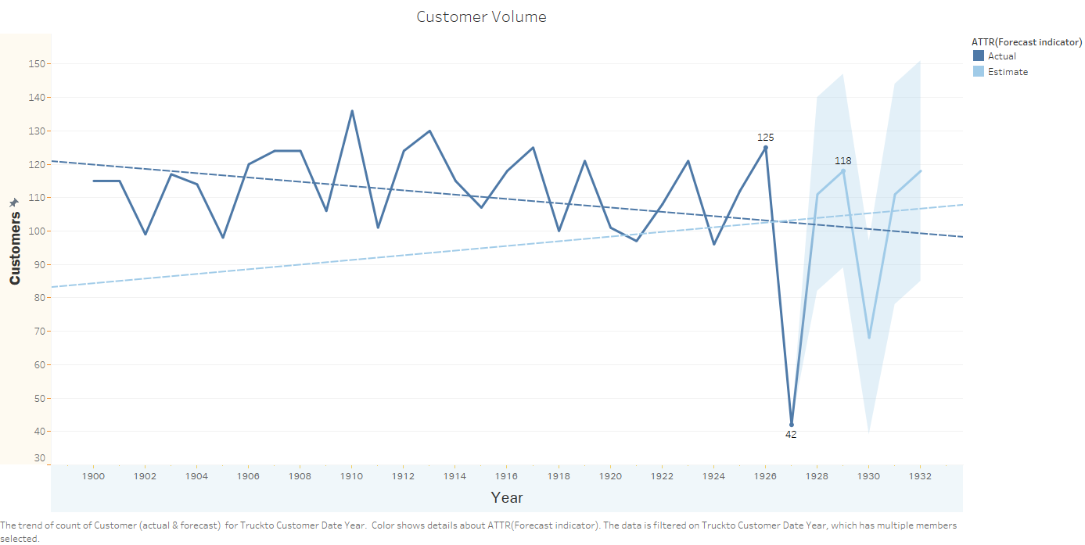

Slide 8
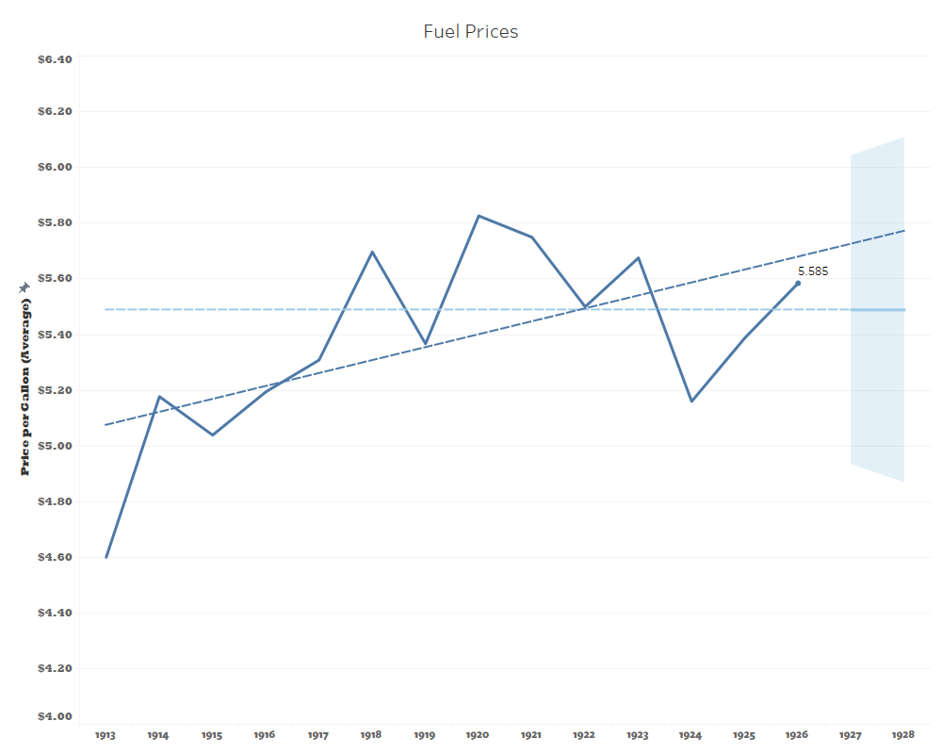

Slide 9
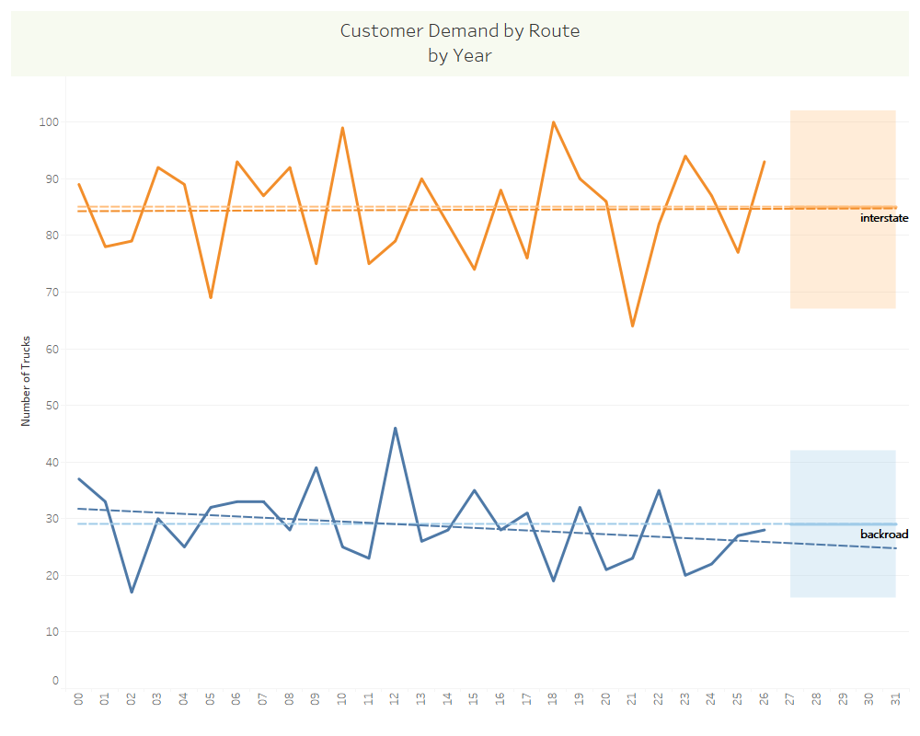

Slide 10

ANALYSIS
A larger city would provide more accessibility to customers via interstate routes
Fuel prices have been rising due to inflation since the company was founded and these prices do not seem correlated with the relocation to Alliance, Nebraska in 1926
Customers prefer interstates to backroads at around a 3:1 ratio, which has not changed in recent years. If anything, backroads are falling out of favor more than ever

Slide 11
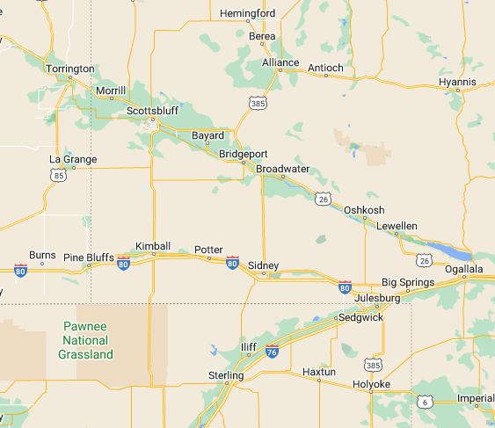
Recommendations
Backroads Bulletin should promptly relocate from Alliance to a larger city in Nebraska, such as Scottsbluff
Backroads should not be used any longer for freight traffic and interstate routes should be used to access Denver
To Denver

Slide 12
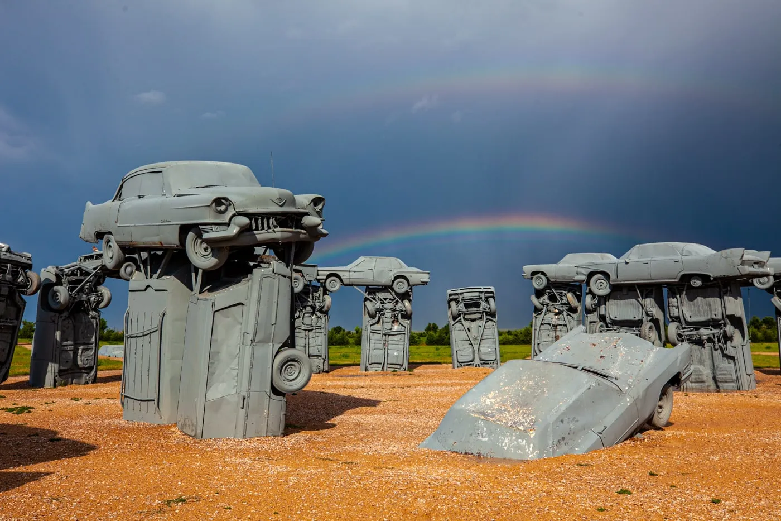
Q&A
Carhenge, Alliance, NE

